Slide 1




(21CC505PC) SOFTWARE ENGINEERING
UPPAL CAMPUS
NARAYANGUDA
IBRAHIMPATNAM
UNIT – 2
GIT AND GITHUB
TOPIC -8
GIT COMMANDS: WORKING WITH LOCAL AND REMOTE REPOSITORIES - BRANCHES, CHECKOUT, MERGE, REVERT, LOG
BY
B MADHURIKA(Ph.D.)
Assistant Professor
CSE

Slide 2

SOFTWARE ENGINEERING
(21CC502PC)
BY
MADHURIKA BUDARAJU
ASSISTANT PROFESSOR
CSE
KMIT

Slide 3
Branches in Git
“A branch is like a separate workspace where you can work on new features or fixes without affecting the main project.”
Types of Branches:
Main Branch (Master): The main, stable version of your project.
Feature Branch: A branch for working on new features.
Bug Fix Branch: A branch specifically for fixing issues.
Release Branch: A branch used for preparing and testing before a release.

Slide 4
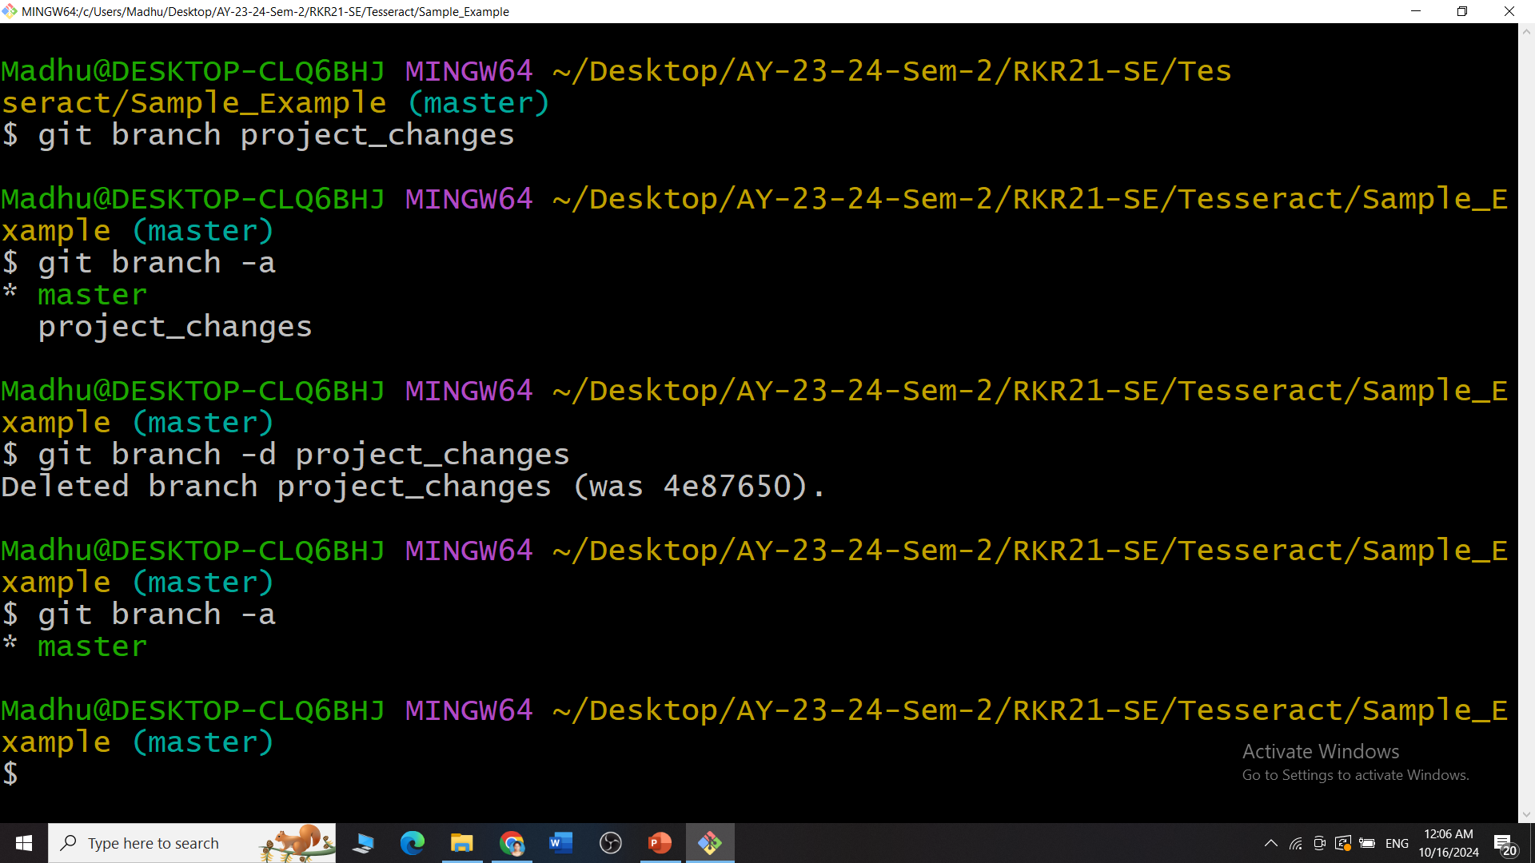
Branches in Git
Important Branch Commands:
git branch <branch_name>: Creates a new branch.
git branch -a: Lists all branches.
git branch -d <branch_name>: Deletes a branch.

Slide 5
Switching Between Branches: Checkout
“The git checkout command allows you to switch between branches, making it easy to work on different tasks.”
When to Use Checkout?
Use checkout when you need to switch from one task or branch to another.
For example, you may need to move from developing a new feature to fixing a bug.

Slide 6
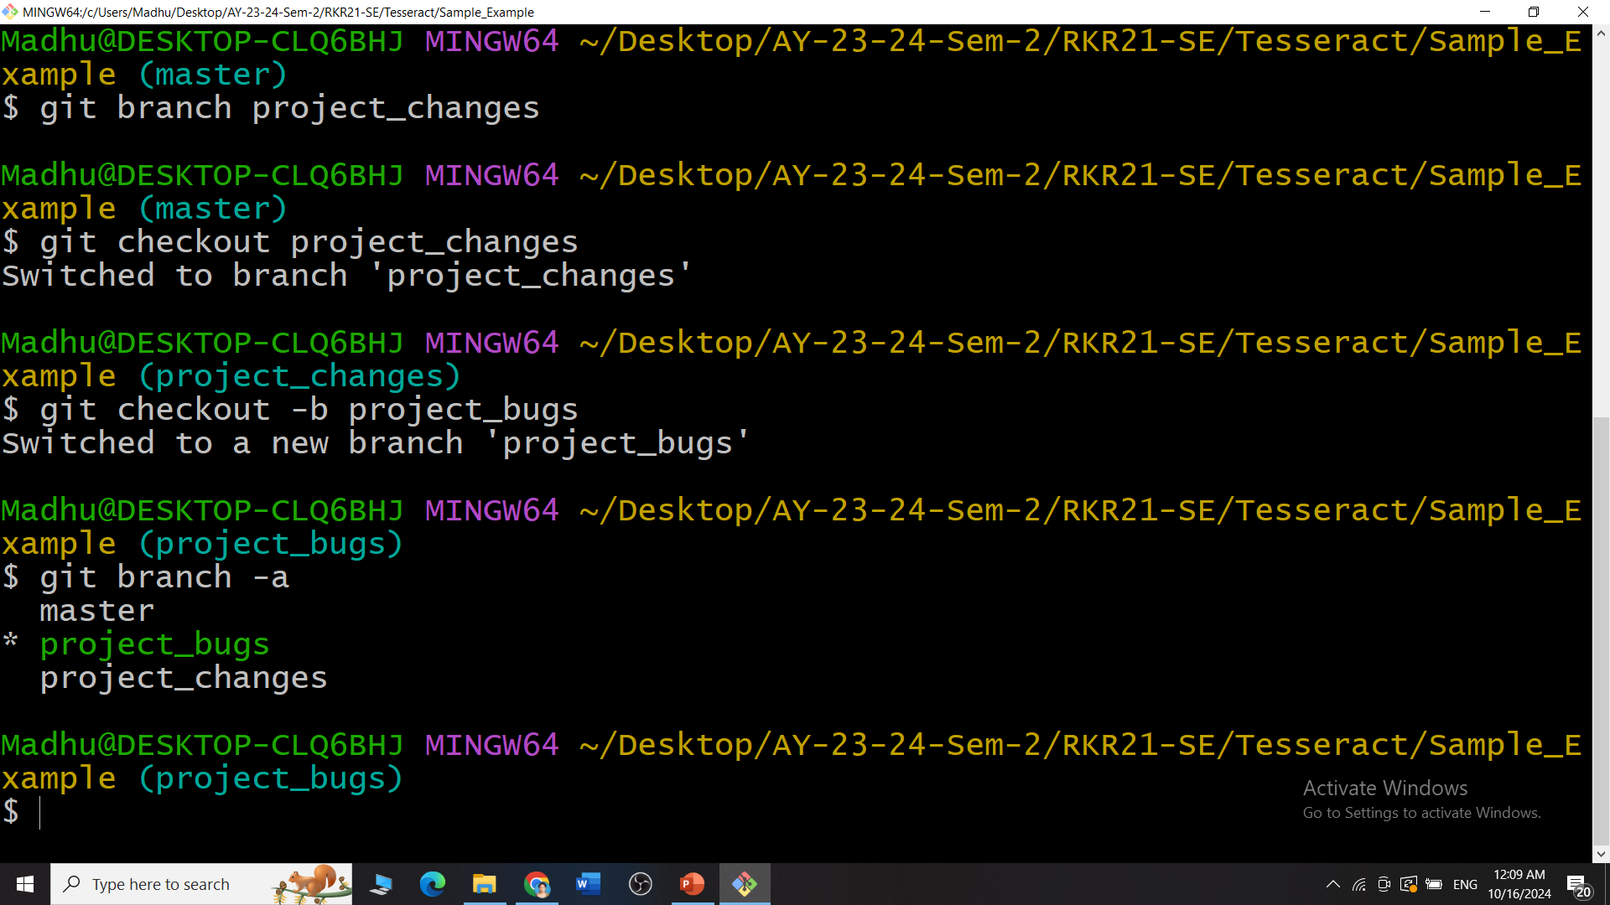
Switching Between Branches: Checkout
Important Checkout Commands:
git checkout <branch_name>: Switch to an existing branch.
git checkout -b <new_branch>: Create and switch to a new branch in one step.

Slide 7
Combining Work: Merge
“The git merge command is used to combine the changes from one branch into another.”
This is usually done when a feature or bug fix is complete.
When to Use Merge?
Once you’ve finished working on a branch, merge it into the main branch so the changes can become part of the main project.

Slide 8
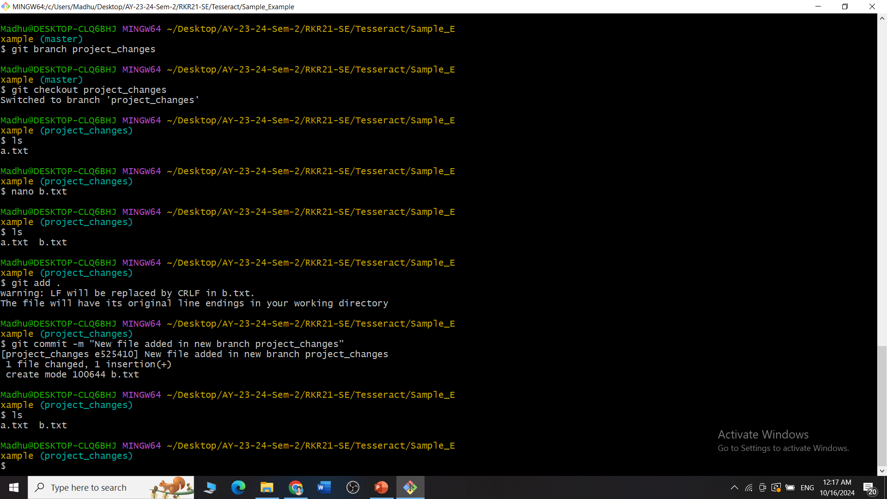
Combining Work: Merge
Important Merge Commands:
git merge <branch_name>: Combines the changes from the specified branch into the current branch.

Slide 9
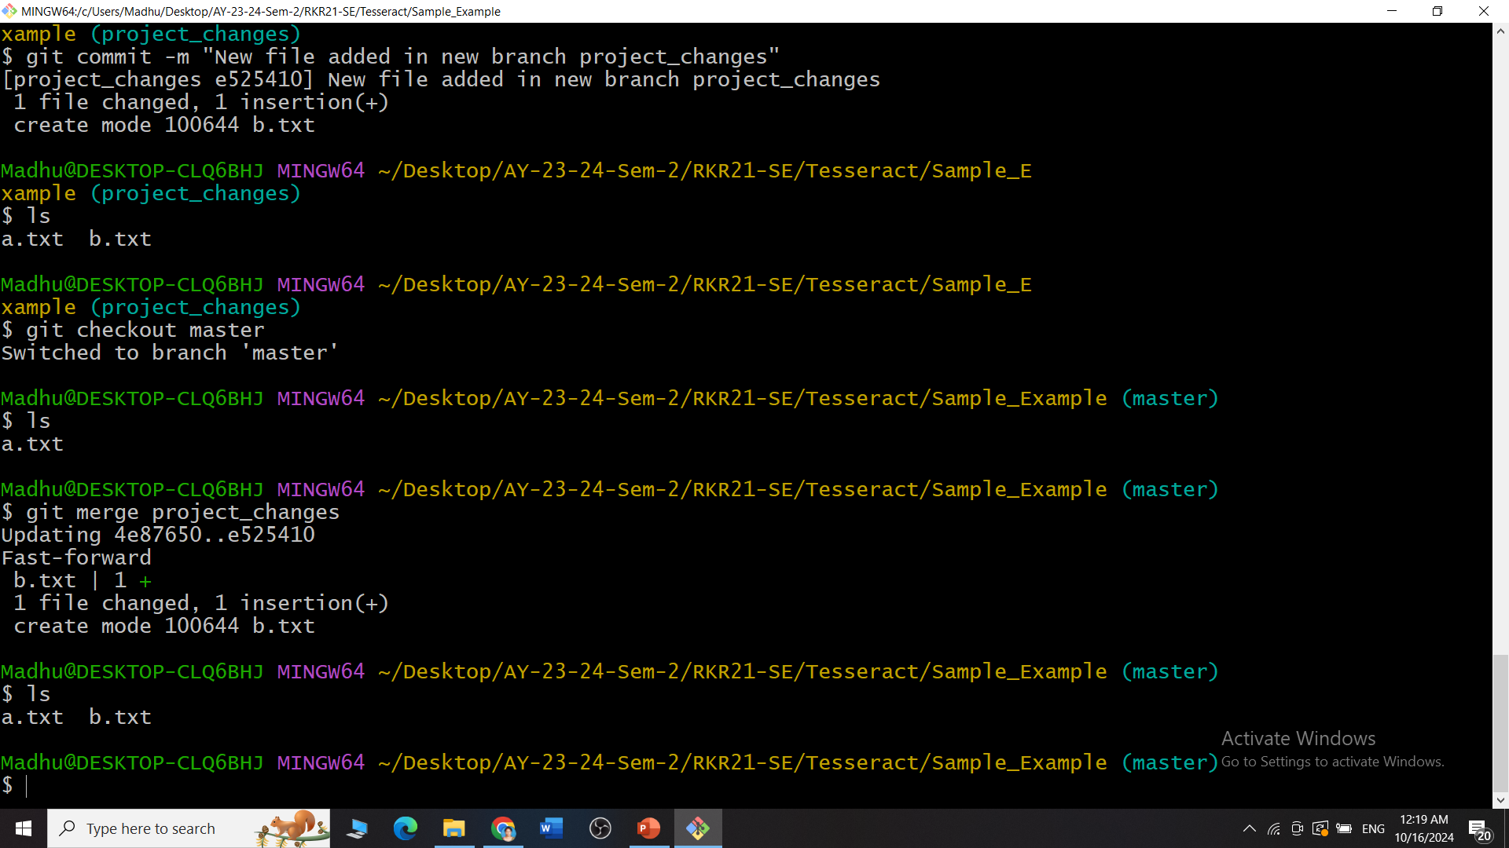
Combining Work: Merge

Slide 10
Viewing History: Log
“The git log command shows a detailed history of all the changes (commits) made in a branch.”
When to Use Log?
Use the log to see what changes were made, by whom, and when. This is helpful when tracking progress or debugging issues.

Slide 11
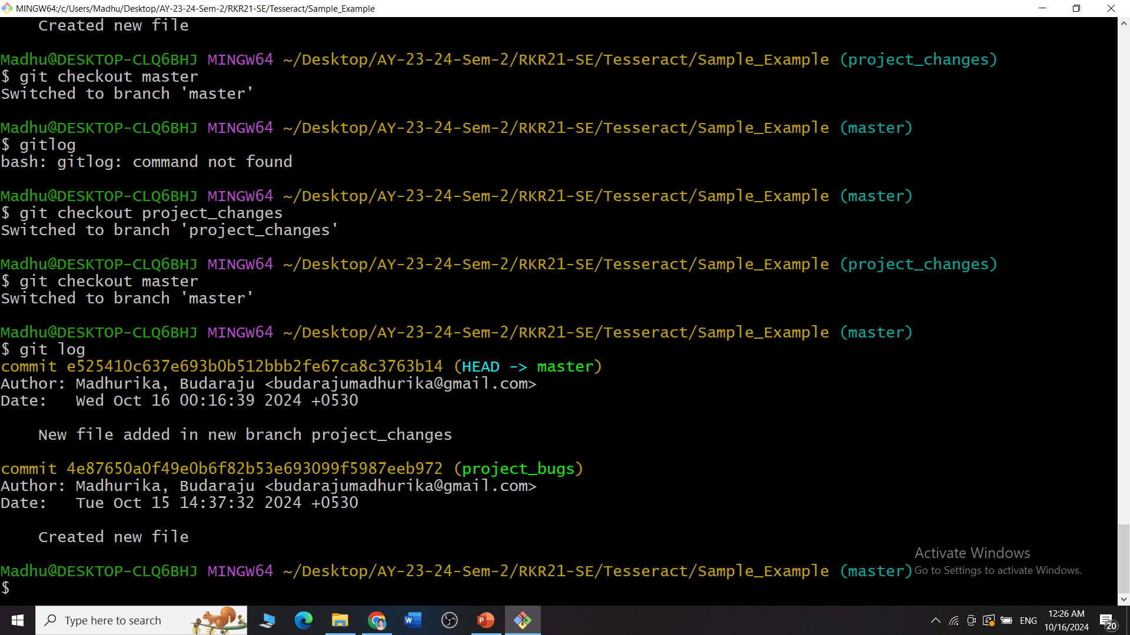
Viewing History: Log
Important Log Commands:
git log: Shows the full history of your project.
Includes:
Commit Hash: A unique ID for each change.
Author: Who made the change.
Date: When the change was made.
Message: A brief description of the change.

Slide 12
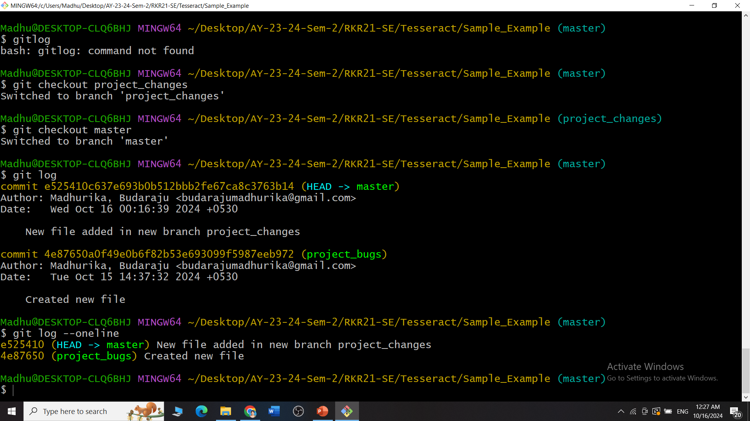
Viewing History: Log
Important Log Commands:
git log –oneline: A simplified version of git log, showing the commit history in one line per commit.
Includes:
Shortened commit hash
Commit message

Slide 13
Undoing Changes: Revert
“The git revert command creates a new commit that undoes the changes made in a previous commit.”
It doesn’t delete the commit but makes a new one that cancels it out.
When to Use Revert?
Use revert when a mistake has been made in a previous commit, but you want to keep a record of the change.

Slide 14
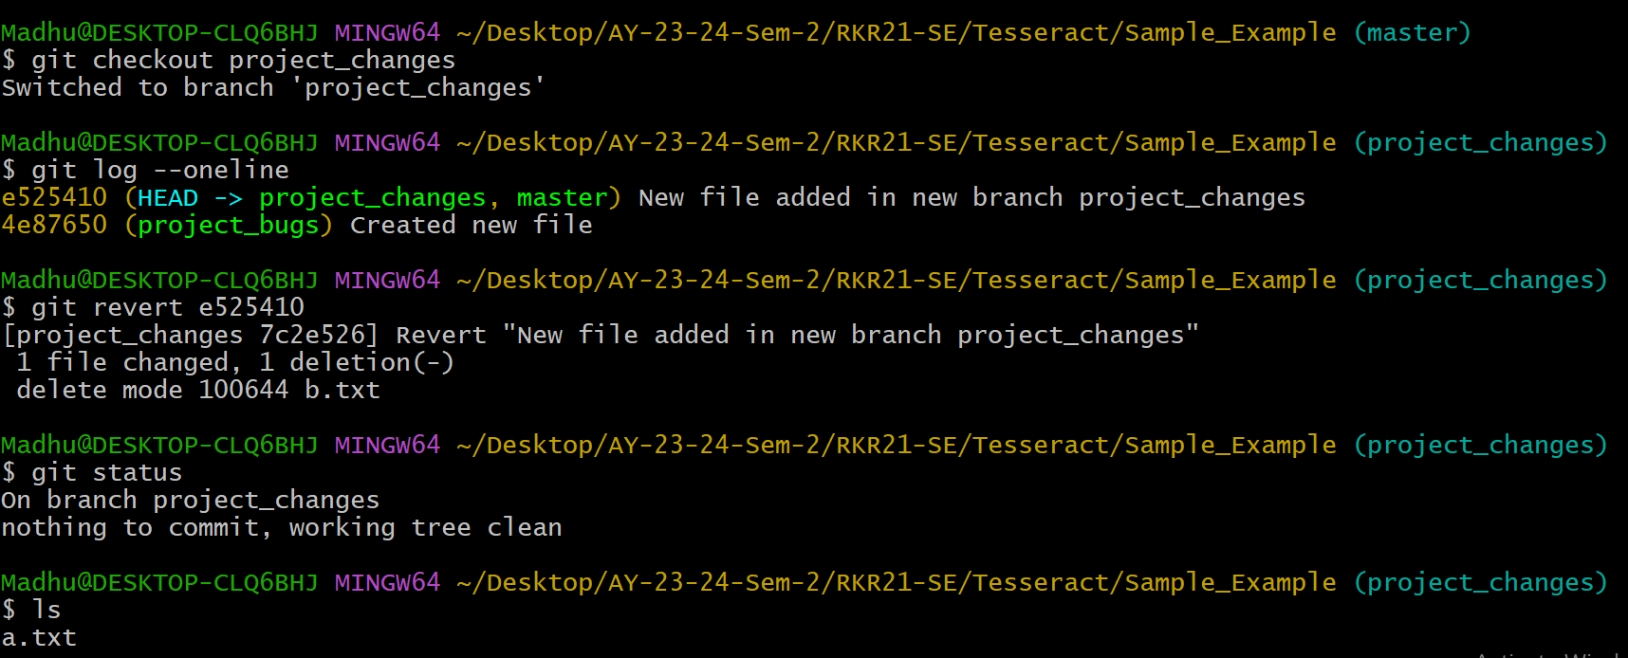
Undoing Changes: Revert
Important Revert Commands:
git revert <commit_hash>: Reverts the changes from a specific commit without deleting the history. Where commit_hash is the ID of the commit.

